Slide 1
Chapter 2: Securing Network Devices
CCNA Security v2.0

Slide 2
Chapter Outline
2.0 Introduction
2.1 Securing Device Access
2.2 Assigning Administrative Roles
2.3 Monitoring and Managing Devices
2.4 Using Automated Security Features
2.5 Securing the Control Plane
2.6 Summary

Slide 3
Section 2.1: Securing Device Access
Upon completion of this section, you should be able to:
Explain how to secure a network perimeter.
Configure secure administrative access to Cisco routers.
Configure enhanced security for virtual logins.
Configure an SSH daemon for secure remote management.

Slide 4
Topic 2.1.1: Securing the Edge Router

Slide 5

Securing the Network Infrastructure
Notes:
2.1.1.1 Securing the Network Infrastructure

Slide 6
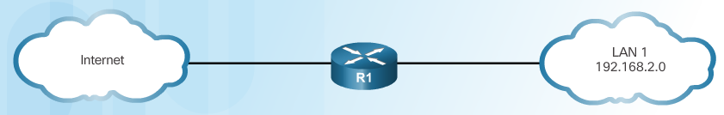
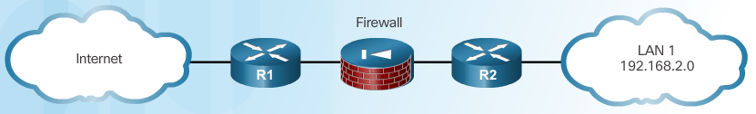
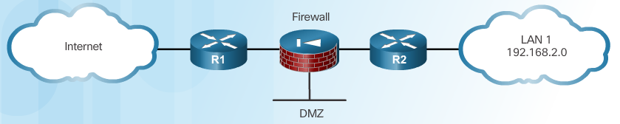
Edge Router Security Approaches
Single Router Approach
Defense in Depth Approach
DMZ Approach
Notes:
2.1.1.2 Edge Router Security Approaches

Slide 7
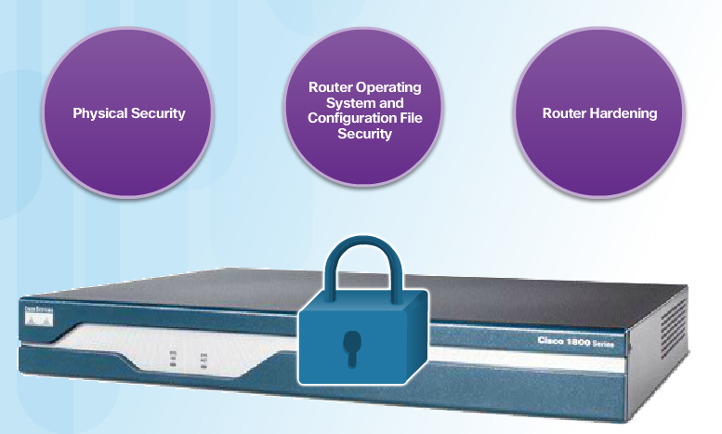
Three Areas of Router Security
Securing the edge router is a critical first step in securing the network. If there are other internal routers, they also must be securely configured. Three areas of router security must be maintained, as shown in the figure.
Router Hardening
Eliminate potential abuse of unused ports and services:
Secure administrative control. Ensure that only authorized personnel have access and that their level of access is controlled.
Disable unused ports and interfaces. Reduce the number of ways a device can be accessed.
Disable unnecessary services. Similar to many computers, a router has services that are enabled by default. Some of these services are unnecessary and can be used by an attacker to gather information about the router and the network, which is then leveraged later in an exploitation attack.
Notes:
2.1.1.3 Three Areas of Router Security

Slide 8
Secure Administrative Access
Tasks:
Restrict device accessibility
Log and account for all access
Authenticate access
Authorize actions
Present legal notification
Ensure the confidentiality of data
Notes:
2.1.1.4 Secure Administrative Access

Slide 9
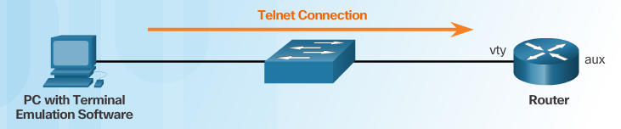
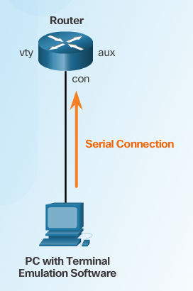
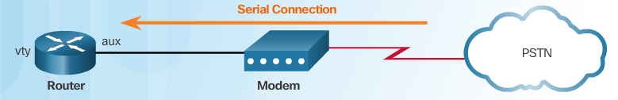
Secure Local and Remote Access
Remote Access Using Telnet
Local Access
Some remote access protocols send the data, including usernames and passwords, to the router in plaintext. If an attacker can collect network traffic while an administrator is remotely logging in to a router, the attacker can capture passwords or router configuration information. For this reason, it is preferable to allow only local access to the router. However, in some situations, remote access might still be necessary. Precautions should be taken when accessing the network remotely:
Remote Access Using Modem and Aux Port
Notes:
2.1.1.5 Secure Local and Remote Access

Slide 10
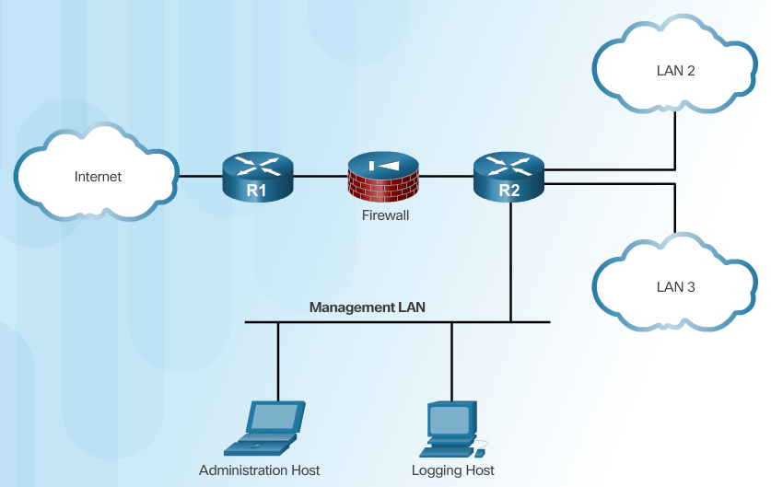
Secure Local and Remote Access (Cont.)
Dedicated Management Network
Notes:
2.1.1.5 Secure Local and Remote Access

Slide 11
Topic 2.1.2: Configuring Secure Administrative Access

Slide 12
Strong Passwords
Guidelines:
Use a password length of 10 or more characters.
Include a mix of uppercase and lowercase letters, numbers, symbols, and spaces.
Avoid passwords based on easily identifiable pieces of information.
Deliberately misspell a password (Smith = Smyth = 5mYth).
Change passwords often.
Do not write passwords down and leave them in obvious places.
Weak Password | Why it is Weak | Strong Password | Why it is Strong
secret | Simple dictionary password | b67n42d39c | Combines alphanumeric characters
smith | Mother’s maiden name | 12^h u4@1p7 | Combines alphanumeric characters, symbols, and includes a space
toyota | Make of car
bob1967 | Name and birthday of user
Blueleaf23 | Simple words and numbers
Notes:
2.1.2.1 Strong Passwords

Slide 13
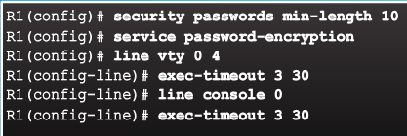
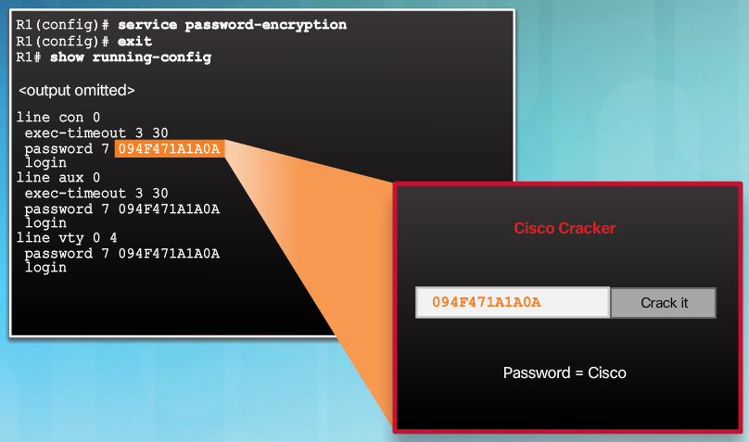
Increasing Access Security
By default, an administrative interface stays active and logged in for 10 minutes after the last session activity. To disable unattended connections, use the exec-timeout minutes [seconds] command in line configuration mode for each of the lines that are configured for access.
Notes:
2.1.2.2 Increasing Access Security

Slide 14
Secret Password Algorithms
Guidelines:
Configure all secret passwords using type 8 or type 9 passwords
Use the enable algorithm-type command syntax to enter an unencrypted password
Use the username name algorithm-type command to specify type 9 encryption
Notes:
2.1.2.3 Secret Password Algorithms

Slide 15
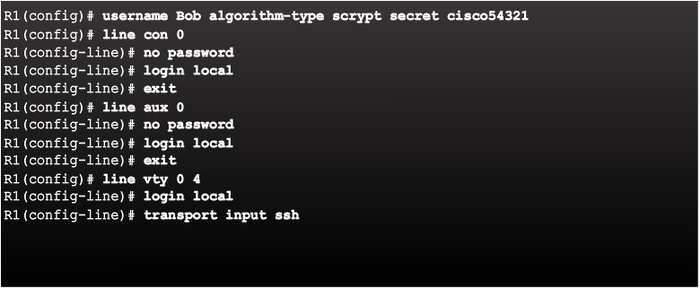
Securing Line Access
By default, the console and auxiliary ports do not require a password for administrative access. In addition, the password command configured on the console, vty, and auxiliary lines can only use type 7. Therefore, you should configure the console and auxiliary lines for username/password authentication with the login local command. In addition, the vty lines should only be configured for SSH access, as shown in Figure 1.
Notes:
2.1.2.4 Securing Line Access
Syntax Checker: Secure Administrative Access on R2

Slide 16
Topic 2.1.3: Configuring Enhanced Security for Virtual Logins

Slide 17
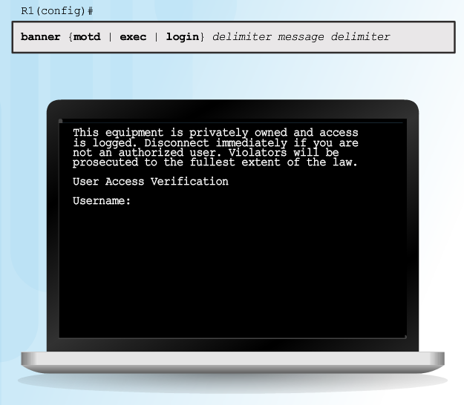
Enhancing the Login Process
Virtual login security enhancements:
Implement delays between successive login attempts
Enable login shutdown if DoS attacks are suspected
Generate system-logging messages for login detection
Notes:
2.1.3.1 Enhancing the Login Process

Slide 18
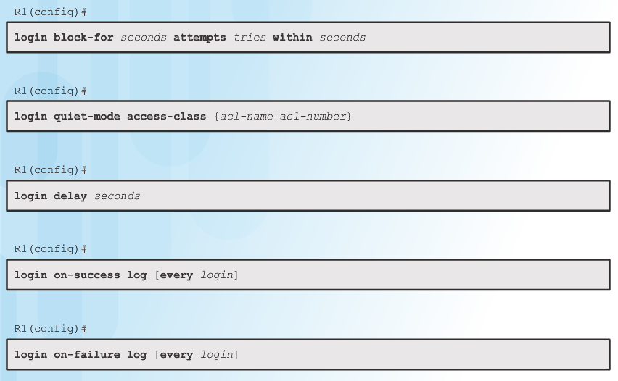
Configuring Login Enhancement Features
The login quiet-mode command maps to an ACL that identifies the permitted hosts. This ensures that only authorized hosts can attempt to login to the router.
The login delay command specifies a number of seconds the user must wait between unsuccessful login attempts.
The login on-success and login on-failure commands log successful and unsuccessful login attempts.
Notes:
2.1.3.2 Configuring Login Enhancement Features

Slide 19
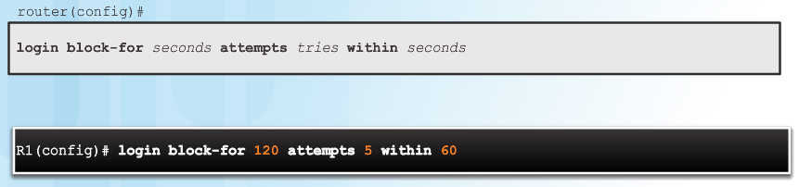
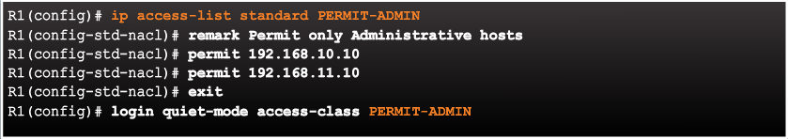
Enable Login Enhancements
Command Syntax: login block-for
Example: login quiet-mode access-class
Example: login delay
Notes:
2.1.3.3 Enable Login Enhancements
Syntax Checker: Configure Enhanced Login Security on R2

Slide 20
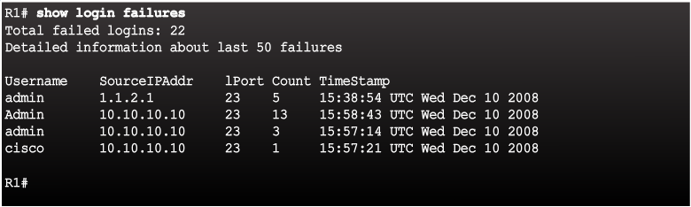
Logging Failed Attempts
Specifically, the login block-for command monitors login device activity and operates in two modes:
Normal mode - This is also known as watch mode. The router keeps count of the number of failed login attempts within an identified amount of time.
Quiet mode - This is also known as the quiet period. If the number of failed logins exceeds the configured threshold, all login attempts using Telnet, SSH, and HTTP are denied for the time specified in the login block-for command.
Generate Login Syslog Messages
Example: show login failures
Notes:
2.1.3.4 Logging Failed Attempts

Slide 21
Topic 2.1.4: Configuring SSH

Slide 22
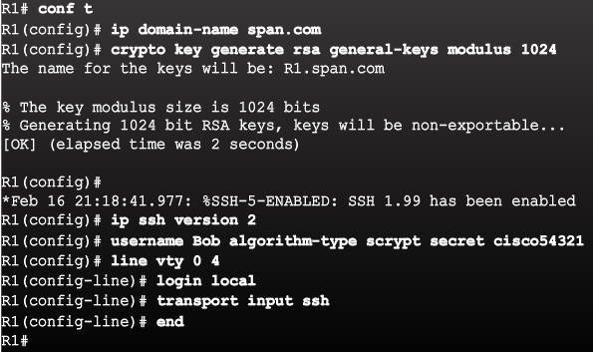
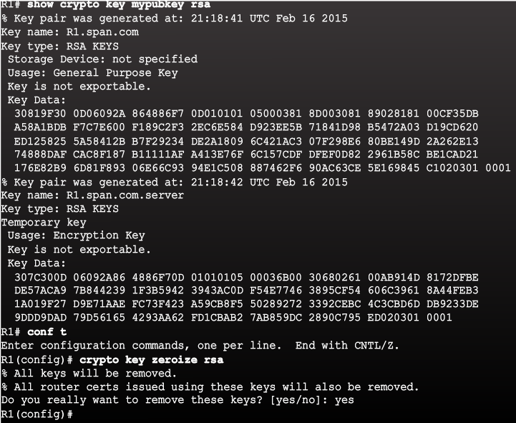
Steps for Configuring SSH
Example SSH Configuration
Example Verification of SSH
Notes:
2.1.4.1 Steps for Configuring SSH

Slide 23
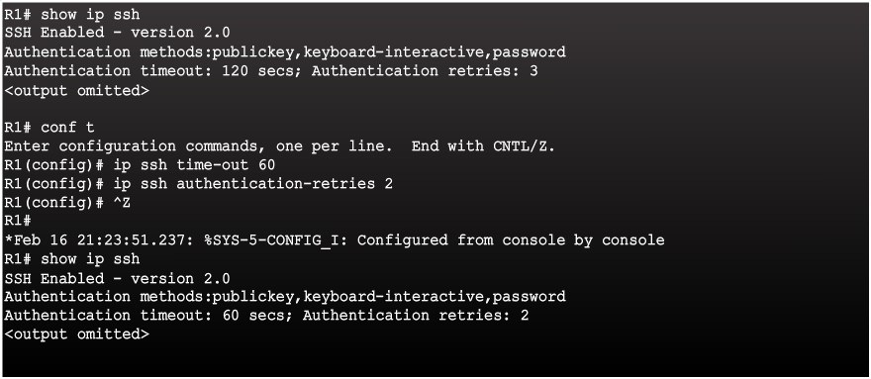
Modifying the SSH Configuration
Notes:
2.1.4.2 Modifying the SSH Configuration
Syntax Checker: Enable SSH on R2

Slide 24
Connecting to an SSH-Enabled Router
Two ways to connect:
Enable SSH and use a Cisco router as an SSH server or SSH client.
As a server, the router can accept SSH client connections
As a client, the router can connect via SSH to another SSH-enabled router
Use an SSH client running on a host, such as PuTTY, OpenSSH, or TeraTerm.
Notes:
2.1.4.3 Connecting to an SSH-Enabled Router

Slide 25
Section 2.2: Assigning Administrative Roles
Upon completion of this section, you should be able to:
Configure administrative privilege levels to control command availability.
Configure role-based CLI access to control command availability.

Slide 26
Topic 2.2.1: Configuring Privilege Levels

Slide 27
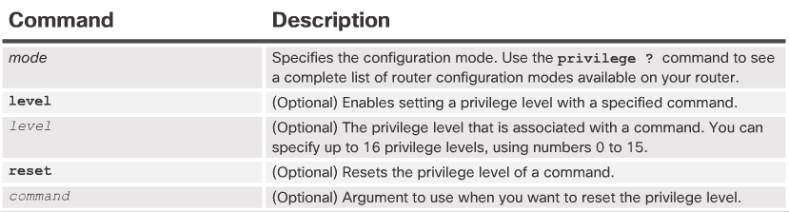
Limiting Command Availability
Privilege levels:
Level 0: Predefined for user-level access privileges.
Level 1: Default level for login with the router prompt.
Level 2-14: May be customized for user-level privileges.
Level 15: Reserved for the enable mode privileges.
Levels of access commands:
User EXEC mode (privilege level 1)
Lowest EXEC mode user privileges
Only user-level command available at the router> prompt
Privileged EXEC mode (privilege level 15)
All enable-level commands at the router# prompt
Privilege Level Syntax
Notes:
2.2.1.1 Limiting Command Availability

Slide 28
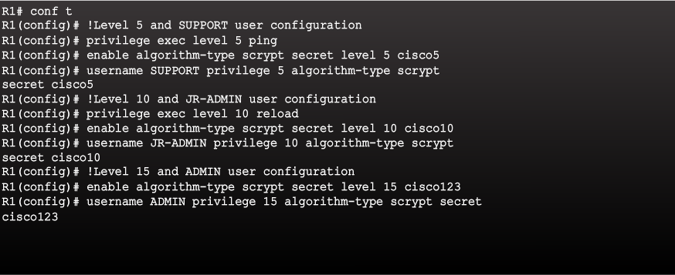
Configuring and Assigning Privilege Levels
Notes:
2.2.1.2 Configuring and Assigning Privilege Levels

Slide 29
Limitations of Privilege Levels
No access control to specific interfaces, ports, logical interfaces, and slots on a router
Commands available at lower privilege levels are always executable at higher privilege levels
Commands specifically set at higher privilege levels are not available for lower privilege users
Assigning a command with multiple keywords allows access to all commands that use those
Notes:
2.2.1.3 Limitations of Privilege Levels
Syntax Checker: Configure Privilege Levels on R2

Slide 30
Topic 2.2.2: Configuring Role-Based CLI
In an effort to provide more flexibility than privilege levels allow, Cisco introduced the role-based CLI access feature in Cisco IOS Release 12.3(11)T. This feature provides finer, more granular access by controlling which commands are available to specific roles

Slide 31
Role-Based CLI Access
For example:
Security operator privileges
Configure AAA
Issue show commands
Configure firewall
Configure IDS/IPS
Configure NetFlow
WAN engineer privileges
Configure routing
Configure interfaces
Issue show commands
Notes:
2.2.2.1 Role-Based CLI Access

Slide 32
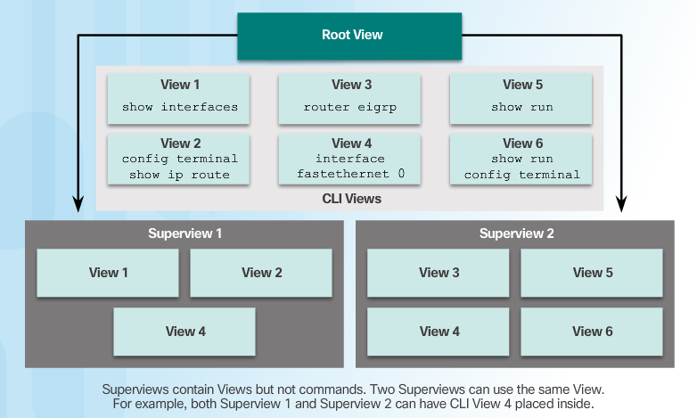
Role-Based Views
Notes:
2.2.2.2 Role-Based Views

Slide 33
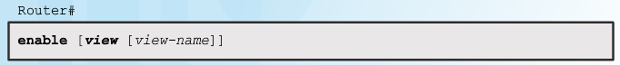
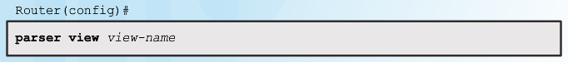
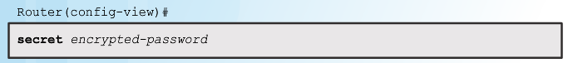
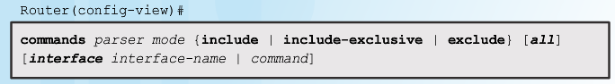
Configuring Role-Based Views
Step 1
Step 2
Step 3
Step 4
Notes:
2.2.2.3 Configuring Role-Based Views
Syntax Checker: Configure Views on R2

Slide 34
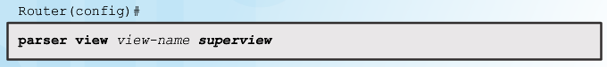
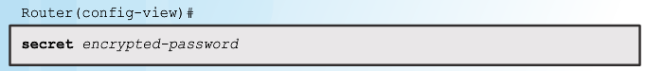
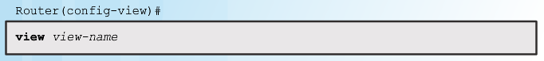
Configuring Role-Based CLI Superviews
Step 1
Step 2
Step 3
Notes:
2.2.2.4 Configuring Role-Based CLI Superviews
Syntax Checker: Configure Superviews on R2

Slide 35
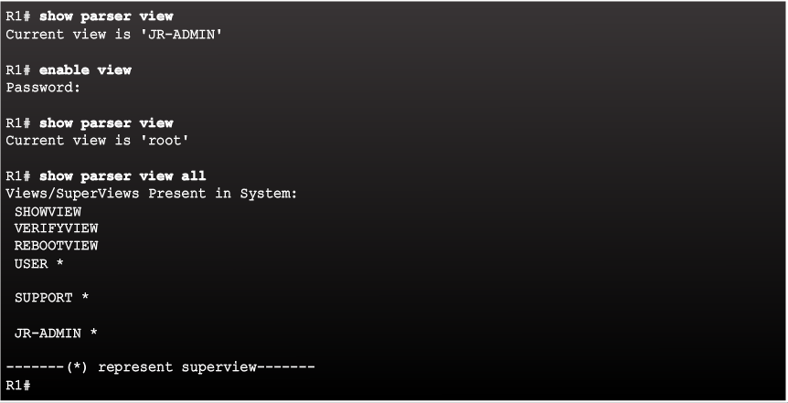
Verify Role-Based CLI Views
Enable Root View and Verify All Views
Notes:
2.2.2.5 Verify Role-Based CLI Views

Slide 36
Section 2.3: Monitoring and Managing Devices
Upon completion of this section, you should be able to:
Use the Cisco IOS resilient configuration feature to secure the Cisco IOS image and configuration files.
Compare in-band and out-of band management access.
Configure syslog to log system events.
Configure secure SNMPv3 access using ACL
Configure NTP to enable accurate timestamping between all devices.

Slide 37
Topic 2.3.1: Securing Cisco IOS Image and Configuration Files

Slide 38
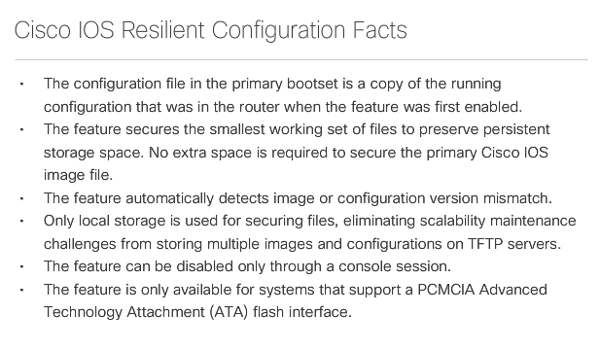
Cisco IOS Resilient Configuration Feature
The Cisco IOS resilient configuration feature allows for faster recovery if someone maliciously or unintentionally reformats flash memory or erases the startup configuration file in nonvolatile random-access memory (NVRAM). The feature maintains a secure working copy of the router IOS image file and a copy of the running configuration file. These secure files cannot be removed by the user and are referred to as the primary bootset.
The figure outlines a few facts about the Cisco IOS resilient configuration.
Notes:
2.3.1.1 Cisco IOS Resilient Configuration Feature

Slide 39
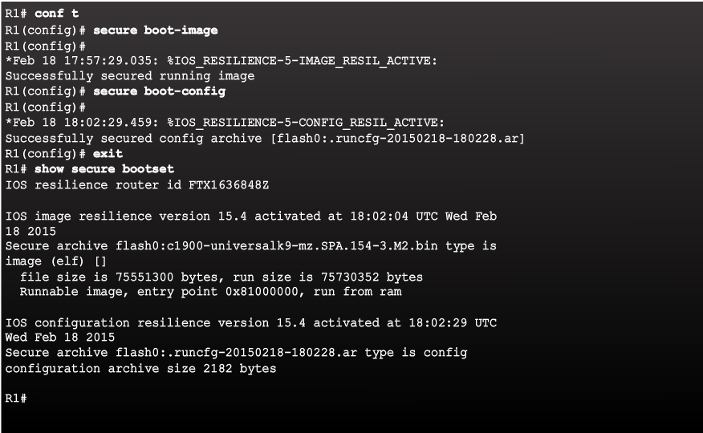
Enabling the IOS Image Resilience Feature
Notes:
2.3.1.2 Enabling the IOS Image Resilience Feature

Slide 40
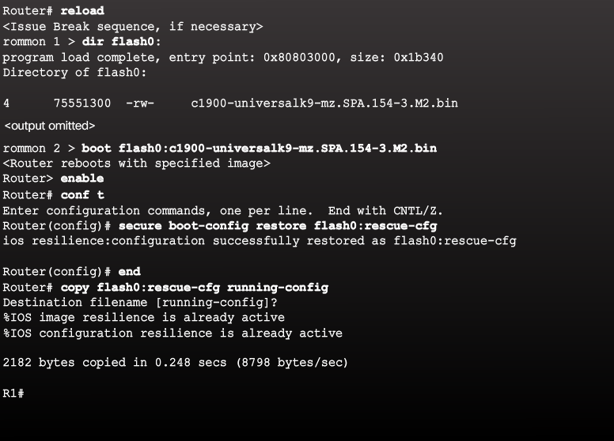
The Primary Bootset Image
Notes:
2.3.1.3 The Primary Bootset Image

Slide 41
Configuring Secure Copy
Configure the router for server-side SCP with local AAA:
Configure SSH
Configure at least one user with privilege level 15
Enable AAA
Specify that the local database is to be used for authentication
Configure command authorization
Enable SCP server-side functionality
The Cisco IOS Resilient feature provides a method for securing the IOS image and configuration files locally on the device. Use the Secure Copy Protocol (SCP) feature to remotely copy these files. SCP provides a secure and authenticated method for copying router configuration or router image files to a remote location. SCP relies on SSH and requires that AAA authentication and authorization be configured so that the router can determine whether the user has the correct privilege level.
Notes:
2.3.1.4 Configuring Secure Copy

Slide 42
Recovering a Router Password
Connect to the console port.
Record the configuration register setting.
Power cycle the router.
Issue the break sequence.
Change the default configuration register with the confreg 0x2142 command.
Reboot the router.
Press Ctrl-C to skip the initial setup procedure.
Put the router into privileged EXEC mode.
Copy the startup configuration to the running configuration.
Verify the configuration.
Change the enable secret password.
Enable all interfaces.
Change the config-register with the config-register configuration_register_setting.
Save the configuration changes.
Notes:
2.3.1.5 Recovering a Router Password

Slide 43
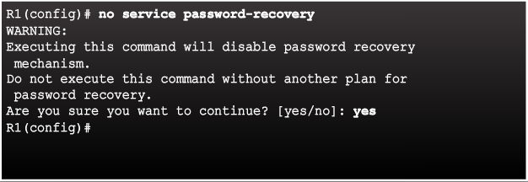
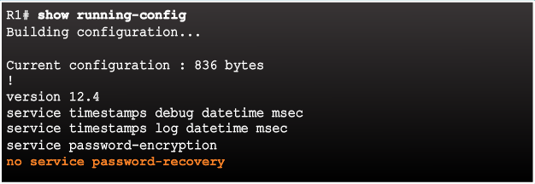
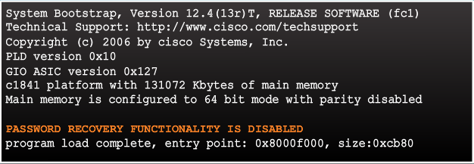
Password Recovery
If someone gained physical access to a router, they could potentially gain control of that device through the password recovery procedure. This procedure, if performed correctly, leaves the router configuration intact. If the attacker makes no major changes, this type of attack is difficult to detect. An attacker can use this attack method to discover the router configuration and other pertinent information about the network, such as traffic flows and access control restrictions.
Disable Password Recovery
An administrator can mitigate this potential security breach by using the no service password-recovery global configuration mode command. This command is a hidden Cisco IOS command and has no arguments or keywords. If a router is configured with the no service password-recovery command, all access to ROMmon mode is disabled.
No Service Password Recovery
Password Recovery Functionality is Disabled
Notes:
2.3.1.6 Password Recovery

Slide 44
Topic 2.3.2: Secure Management and Reporting

Slide 45
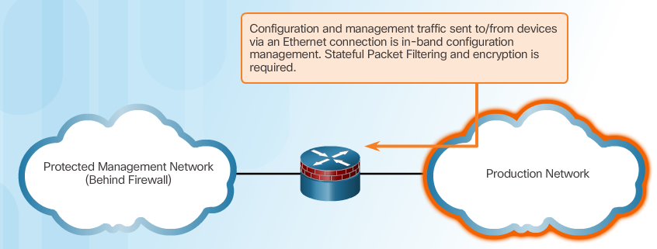
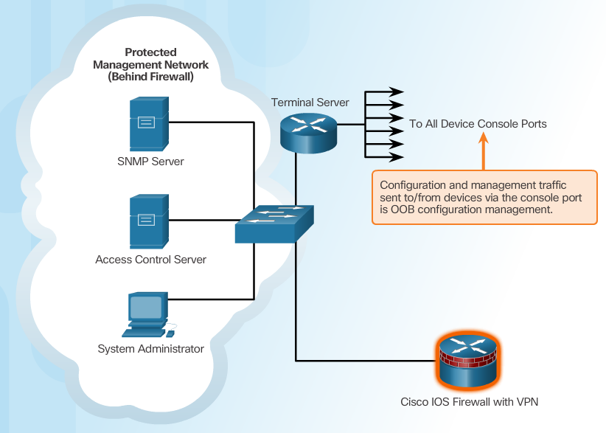
Determining the Type of Management Access
In-Band Management:
Apply only to devices that need to be managed or monitored
Use IPsec, SSH, or SSL when possible
Decide whether the management channel need to be open at all time
Out-of-Band (OOB) Management:
Provide highest level of security
Mitigate the risk of passing management protocols over the production network
Notes:
2.3.2.1 Determining the Type of Management Access
2.3.2.2 Out-of-Band and In-Band Access

Slide 46
Topic 2.3.3: Using Syslog for Network Security

Slide 47
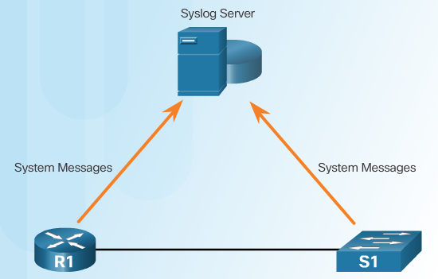
Introduction to Syslog
Implementing a logging facility is an important part of any network security policy. When certain events occur on a network, networking devices have trusted mechanisms to notify the administrator with detailed system messages. These messages can be non-critical or significant, and there are several options available to store, interpret, and display them. Administrators can be alerted to all of the messages or only the messages that may have the greatest impact on the network infrastructure.
The most common method of accessing system messages from networking devices is to use a protocol called syslog, which is described in RFC 5424.
Notes:
2.3.3.1 Introduction to Syslog

Slide 48
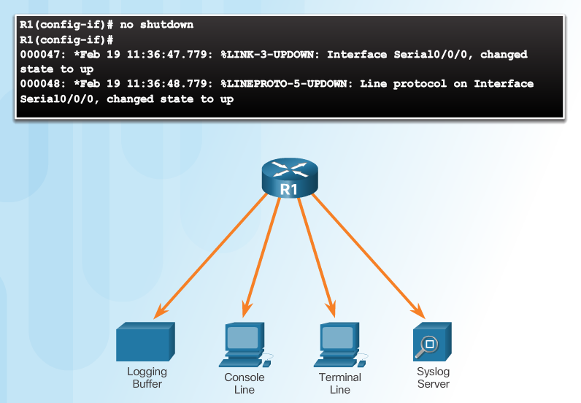
Syslog Operation
Notes:
2.3.3.2 Syslog Operation

Slide 49
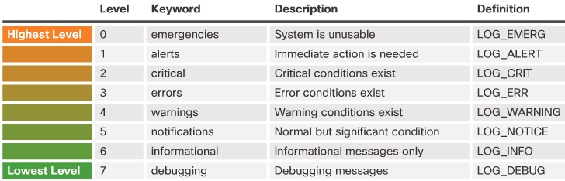
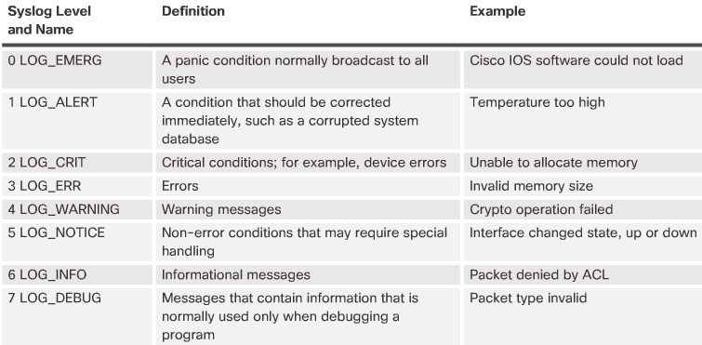
Syslog Message
Security Levels
Every Alley Cat Eats Watery Noodles In Doors
Example Severity Levels
Notes:
2.3.3.3 Syslog Message

Slide 50
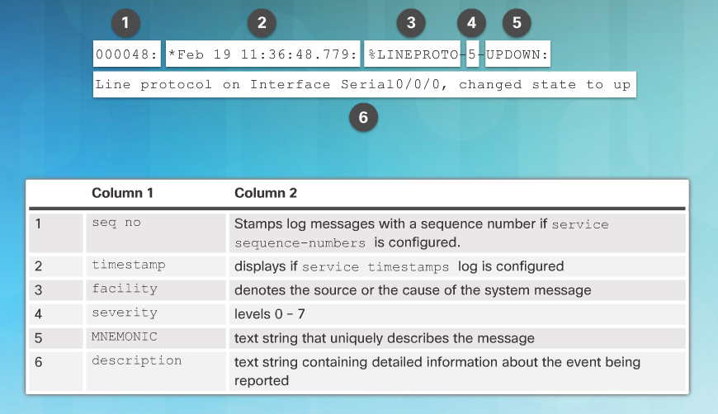
Syslog Message (Cont.)
Notes:
2.3.3.3 Syslog Message
2.3.3.4 Activity - Parts 1-3 : Interpret Syslog Output

Slide 51
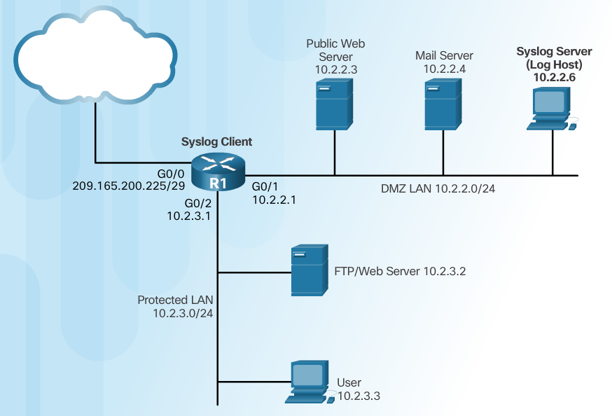
Syslog Systems
Syslog implementations always contain two types of systems:
Syslog servers - Also known as log hosts, these systems accept and process log messages from syslog clients.
Syslog clients - Routers or other types of equipment that generate and forward log messages to syslog servers.
Notes:
2.3.3.5 Syslog Systems

Slide 52
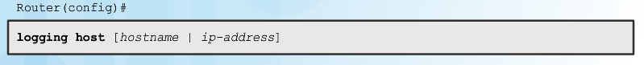
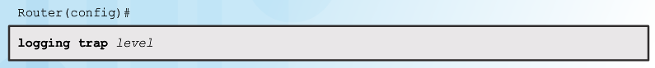
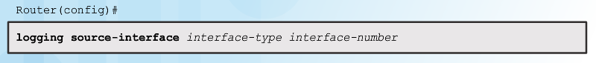
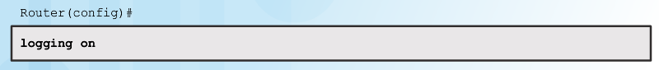
Configuring System Logging
Step 1
Step 2 (optional)
Step 3
Step 4
Notes:
2.3.3.6 Configuring System Logging

Slide 53
Topic 2.3.4: Using SNMP for Network Security

Slide 54
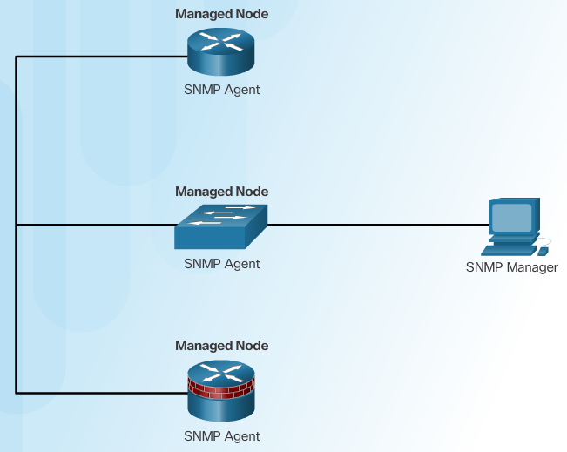
Introduction to SNMP
Another common monitoring tool is Simple Network Management Protocol (SNMP). SNMP was developed to allow administrators to manage devices on an IP network. It enables network administrators to monitor network performance, manage network devices, troubleshoot network problems, and plan for network growth.
SNMP consists of three elements relevant to the Network Management System (NMS):
SNMP manager
SNMP agents (managed node)
Management Information Base (MIB)
Notes:
2.3.4.1 Introduction to SNMP

Slide 55
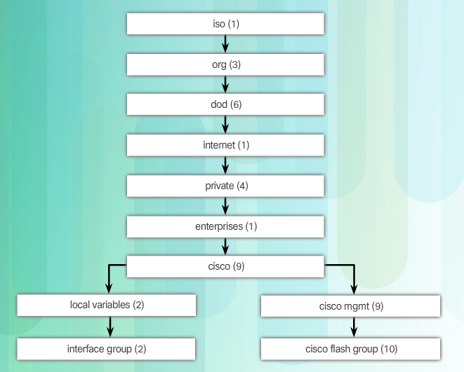
Management Information Base
Cisco MIB Hierarchy
Notes:
2.3.4.2 Management Information Base

Slide 56

SNMP Versions
Notes:
2.3.4.3 SNMP Versions

Slide 57

SNMP Vulnerabilities
Notes:
2.3.4.4 SNMP Vulnerabilities

Slide 58

SNMPv3
Message integrity & authentication
Encryption
Access control
Transmissions from manager to agent may be authenticated to guarantee the identity of the sender and the integrity and timeliness of a message.
SNMPv3 messages may be encrypted to ensure privacy.
Agent may enforce access control to restrict each principal to certain actions on specific portions of data.
Notes:
2.3.4.5 SNMPv3

Slide 59

Configuring SNMPv3 Security
Notes:
2.3.4.6 Configuring SNMPv3 Security

Slide 60

Secure SNMPv3 Configuration Example
Notes:
2.3.4.7 Secure SNMPv3 Configuration Example
Syntax Checker: Configure SNMPv3 Authentication Using an ACL

Slide 61

Verifying the SNMPv3 Configuration
Notes:
2.3.4.8 Verifying the SNMPv3 Configuration

Slide 62
Topic 2.3.5: Using NTP

Slide 63

Network Time Protocol
Notes:
2.3.5.1 Network Time Protocol

Slide 64



NTP Server
Sample NTP Topology
Sample NTP Configuration on R1
Sample NTP Configuration on R2
Notes:
2.3.5.2 NTP Server

Slide 65

NTP Authentication
Notes:
2.3.5.3 NTP Authentication
Syntax Checker: Configure NTP Authentication on R1

Slide 66
Section 2.4: Using Automated Security Features
Upon completion of this section, you should be able to:
Use security audit tools to determine IOS-based router vulnerabilities.
Use AutoSecure to enable security on IOS-based routers.

Slide 67
Topic 2.4.1: Performing a Security Audit

Slide 68


Discovery Protocols CDP and LLDP
Notes:
2.4.1.1 Discovery Protocols CDP and LLDP

Slide 69
Settings for Protocols and Services
There is a detailed list of security settings for protocols and services provided in Figure 2 of this page in the course.
Additional recommended practices to ensure a device is secure:
Disable unnecessary services and interfaces.
Disable and restrict commonly configured management services.
Disable probes and scans. Ensure terminal access security.
Disable gratuitous and proxy ARPs
Disable IP-directed broadcasts.
Notes:
2.4.1.2 Settings for Protocols and Services

Slide 70
Topic 2.4.2: Locking Down a Router Using AutoSecure

Slide 71

Cisco AutoSecure
Notes:
2.4.2.1 Cisco AutoSecure

Slide 72


Using the Cisco AutoSecure Feature
Notes:
2.4.2.2 Using the Cisco AutoSecure Feature

Slide 73
Using the auto secure Command
The auto secure command is entered
Wizard gathers information about the outside interfaces
AutoSecure secures the management plane by disabling unnecessary services
AutoSecure prompts for a banner
AutoSecure prompts for passwords and enables password and login features
Interfaces are secured
Forwarding plane is secured
Notes:
2.4.2.3 Using the auto secure Command
Syntax Checker: Use AutoSecure to Secure R1

Slide 74
Section 2.5: Securing the Control Plane
Upon completion of this section, you should be able to:
Configure a routing protocol authentication.
Explain the function of Control Plane Policing.

Slide 75
Topic 2.5.1: Routing Protocol Authentication

Slide 76
Routing Protocol Spoofing
Consequences of protocol spoofing:
Redirect traffic to create routing loops.
Redirect traffic so it can be monitored on an insecure link.
Redirect traffic to discard it.
Notes:
2.5.1.1 Routing Protocol Spoofing

Slide 77

OSPF MD5 Routing Protocol Authentication
Notes:
2.5.1.2 OSPF MD5 Routing Protocol Authentication

Slide 78

OSPF SHA Routing Protocol Authentication
Notes:
2.5.1.3 OSPF SHA Routing Protocol Authentication
Syntax Checker: Configure OSPF Authentication Using SHA 256

Slide 79
Topic 2.5.2: Control Plane Policing

Slide 80

Network Device Operations
While the primary function of routers is to forward user-generated content across the data plane, routers also generate and receive traffic destined for the control and management planes. Therefore, routers must be able to distinguish between data plane, control plane, and management plane packets to treat each packet appropriately, as shown in the figure.
Control plane packets - Network device generated or received packets that are used for the creation and operation of the network. Examples include protocols, such as OSPF, ARP, Border Gateway Protocol (BGP), and other protocols that keep the network converged and operating properly. Control plane packets are generally packets sent to the router or network device. The destination IP address is that of the router.
Management plane packets - Network device generated or received packets that are used to manage the network. Examples include protocols, such as Telnet, SSH, SNMP, NTP, and other protocols used to manage the device or network.
Notes:
2.5.2.1 Network Device Operations

Slide 81

Control and Management Plane Vulnerabilities
The router processor (the CPU in the control plane) is significantly less capable of handling the kinds of packet rates experienced by CEF, and therefore, it is never directly involved in the forwarding of data plane packets.
In contrast, when high packet rates overload the control or management plane, route processor resources can be overwhelmed. This reduces the availability of these resources for tasks critical to the operation and maintenance of the network. Malicious and non-malicious events can overwhelm route processor resources
An interface ACL is the traditional and most generally available approach for managing all packets entering or exiting a network device. ACLs are well understood and are generally applicable to data, services, control, and management plane packets. As shown in the figure, ACLs are applied at the interface level to each packet ingressing (or egressing) the interface, not just control plane packets. In addition, ACLs must be applied to every interface to which the policy is to be applied. On large routers, this can be a time-consuming task
Notes:
2.5.2.2 Control and Management Plane Vulnerabilities

Slide 82

CoPP Operation
Control Plane Policing (CoPP) is a Cisco IOS feature designed to allow administrators to manage the flow of traffic that is “punted” to the route processor, as shown in the figure. The term “punt” is defined by Cisco to describe the action an interface takes when sending a packet to the route processor. CoPP is designed to prevent unnecessary traffic from overwhelming the route processor that, if left unabated, could affect system performance.
CoPP protects the route processor on network devices by treating route processor resources as a separate entity with its own interface. Consequently, a CoPP policy can be developed and applied to only those packets within the control plane. Unlike interface ACLs, no effort is wasted investigating data plane packets that will never reach the control plane.
CoPP configuration is beyond the scope of this course.
Notes:
2.5.2.3 CoPP Operation
2.5.2.4 Activity - Identify the Features of CoPP
2.5.2.5 Activity - Identify the Network Device Security Features

Slide 83
Section 2.6: Summary
Chapter Objectives:
Configure secure administrative access.
Configure command authorization using privilege levels and role-based CLI.
Implement the secure management and monitoring of network devices.
Use automated features to enable security on IOS-based routers.
Implement control plane security.
Notes:
2.6.1.1 Packet Tracer - Configure Cisco Routers for Syslog, NTP, and SSH Operations

Slide 85


Instructor Resources
Remember, there are helpful tutorials and user guides available via your NetSpace home page. (https://www.netacad.com)
These resources cover a variety of topics including navigation, assessments, and assignments.
A screenshot has been provided here highlighting the tutorials related to activating exams, managing assessments, and creating quizzes.
1
2
Notes:
https://www.netacad.com

